Slide 1
Capstone Project - The Battle of the Neighborhoods (Week 2)
Applied Data Science Capstone by IBM/Coursera

Slide 2
Table of Contents
Introduction: Business Problem
Data
Methodology
Analysis
Results and Discussion
Conclusion

Slide 3
Introduction: Business Problem
In this project we will try to find an optimal location for a restaurant. Specifically, this report will be targeted to stakeholders interested in opening an Indian restaurant in Frisco, Texas.
Since there are lots of restaurants in Frisco we will try to detect locations that are not already crowded with restaurants. We are also particularly interested in areas with no Indian restaurants in vicinity. We would also prefer locations as close to city center as possible, assuming that first two conditions are met.
We will use our data science powers to generate a few most promising neighborhoods based on this criteria. Advantages of each area will then be clearly expressed so that best possible final location can be chosen by stakeholders.

Slide 4
Data
Based on definition of our problem, factors that will influence our decision are:
number of existing restaurants in the neighborhood (any type of restaurant)
number of and distance to Indian restaurants in the neighborhood, if any
distance of neighborhood from city center
We decided to use regularly spaced grid of locations, centered around city center, to define our neighborhoods. Following data sources will be needed to extract/generate the required information:
centers of candidate areas will be generated algorithmically and approximate addresses of centers of those areas will be obtained using **Google Maps API reverse geocoding**
number of restaurants and their type and location in every neighborhood will be obtained using **Foursquare API**
coordinate of Frisco center will be obtained using **Google Maps API geocoding** of well known Frisco location (Frisco Main Street)

Slide 5
Neighborhood Candidates
Let's create latitude & longitude coordinates for centroids of our candidate neighborhoods. We will create a grid of cells covering our area of interest which is approx.. 8X8 miles centered around Frisco city center.
Let's first find the latitude & longitude of Frisco city center, using specific, well known address and Google Maps geocoding API.

Slide 6
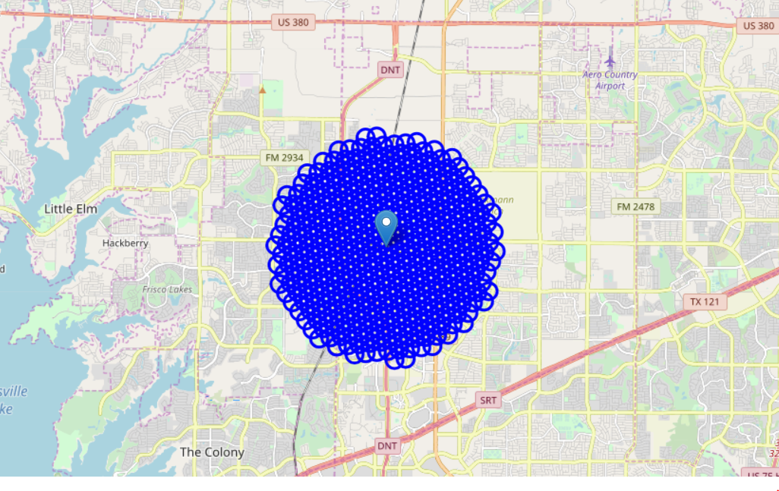
City Center and neighborhood centers

Slide 7
Foursquare
Now that we have our location candidates, let's use Foursquare API to get info on restaurants in each neighborhood.
We're interested in venues in 'food' category, but only those that are proper restaurants - coffee shops, pizza places, bakeries etc. are not direct competitors so we don't care about those. So we will include in out list only venues that have 'restaurant' in category name, and we'll make sure to detect and include all the subcategories of specific 'Italian restaurant' category, as we need info on Italian restaurants in the neighborhood.

Slide 8
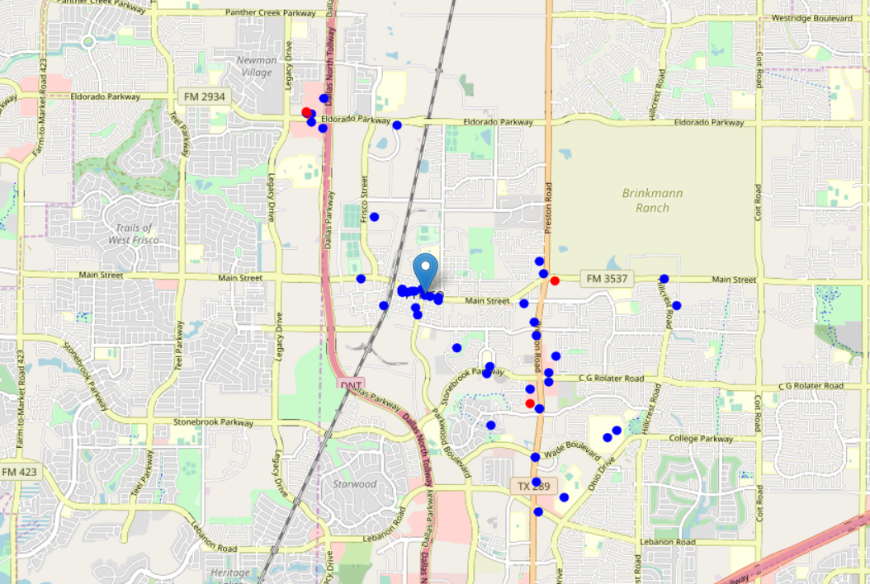
All restaurants in our area of interest on map

Slide 9
Methodology
In first step we have collected the required **data: location and type (category) of every restaurant within 4 mile radius from Frisco center). We have also identified Indian restaurants (according to Foursquare categorization).
Second step in our analysis will be calculation and exploration of restaurant density across different areas of Frisco - we will use heatmaps to identify a few promising areas close to center with low number of restaurants in general (and no Indian restaurants in vicinity) and focus our attention on those area.
In third and final step we will focus on most promising areas and within those create clusters of locations that meet some basic requirements established in discussion with stakeholders: we will take into consideration locations with no more than two restaurants in radius of 250 meters, and we want locations without Indian restaurants in radius of 400 meters. We will present map of all such locations but also create clusters (using k-means clustering) of those locations to identify general zones / neighborhoods / addresses which should be a starting point for final 'street level' exploration and search for optimal venue location by stakeholders.

Slide 10
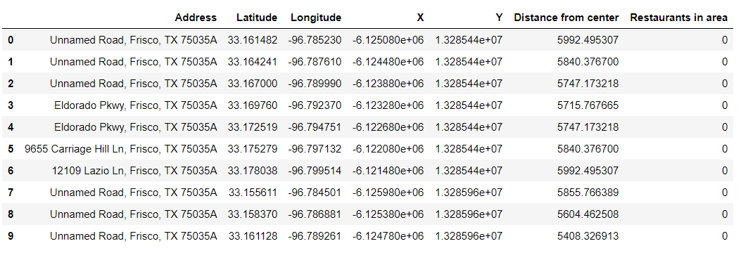
Analysis
Average number of restaurants in every area with 300 m radius=0.31

Slide 11
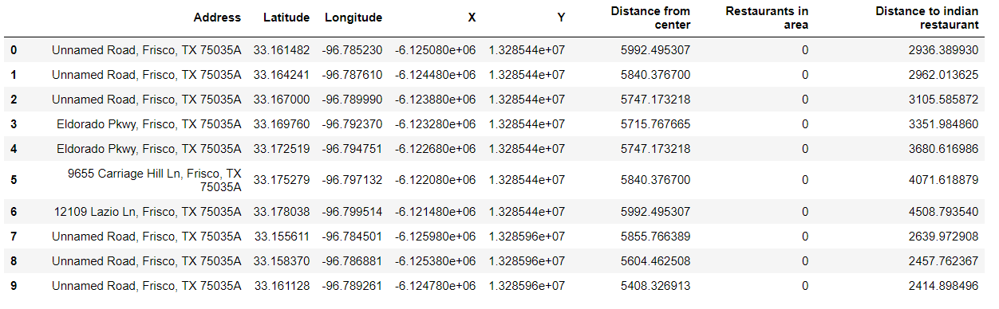
Analysis
Average distance to the closest Indian restaurant=3093.58

Slide 12
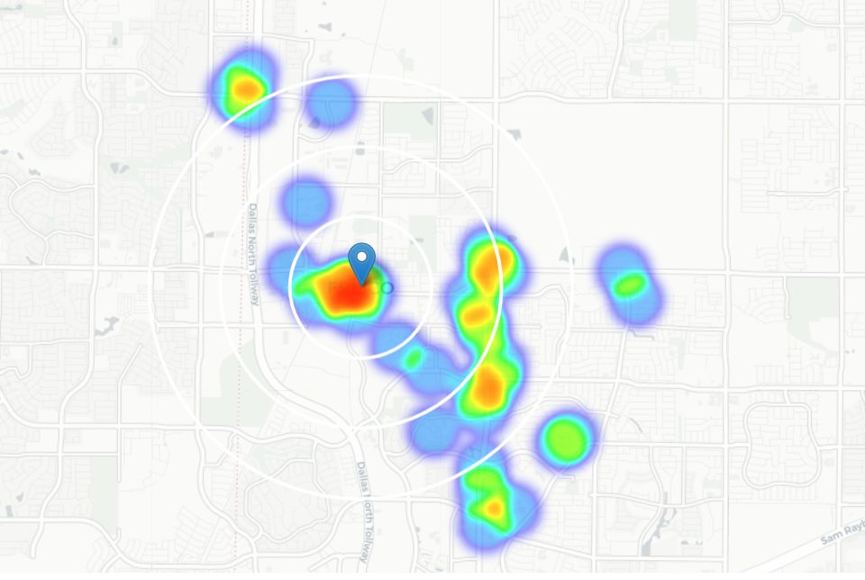
Heatmap/Density of restaurants

Slide 13
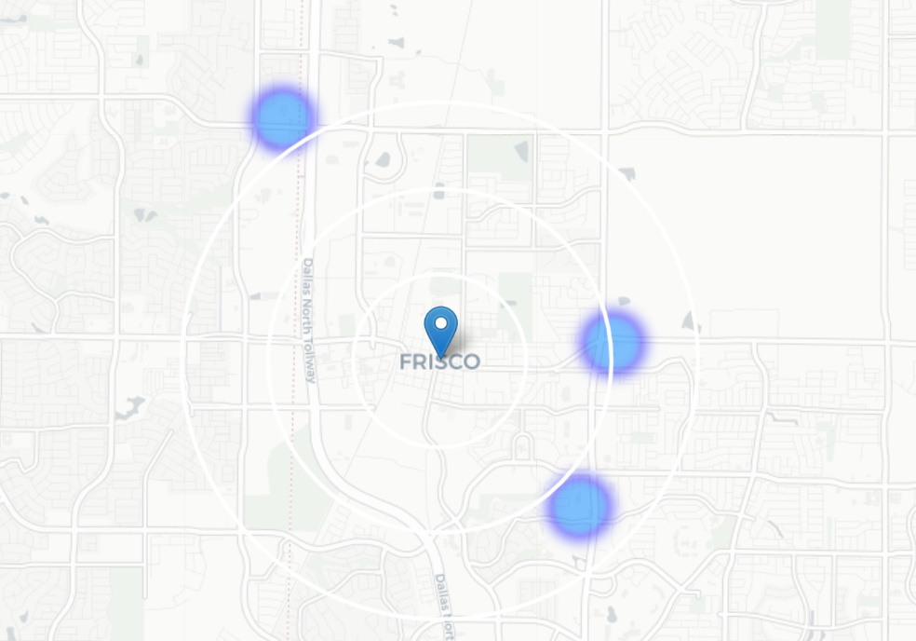
Heatmap/Density of Indian restaurants
This map is not so 'hot' (Indian restaurants represent a subset of ~8% of all restaurants in Frisco) but it also indicates higher density of existing Indian restaurants directly north and west from Frisco, with closest pockets of **low Indian restaurant density positioned North, North-west and south from city center**.
Based on this we will now focus our analysis on areas *south-west, south, south-east and east from Frisco center* - we will move the center of our area of interest and reduce it's size to have a radius of **2 miles**. This places our location candidates mostly in closer to Little Elm and Prosper

Slide 14
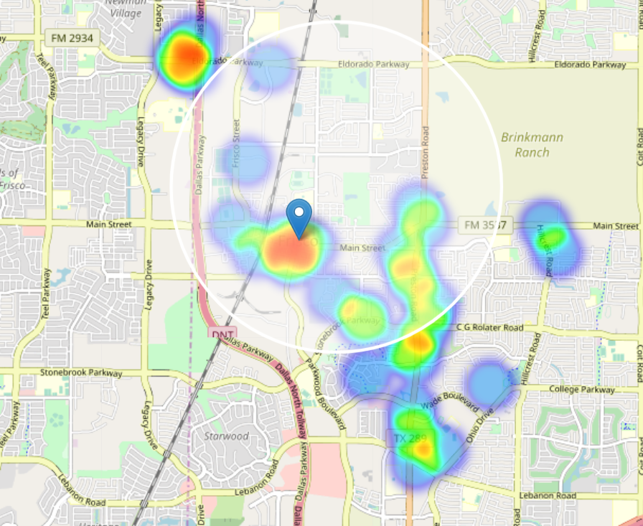
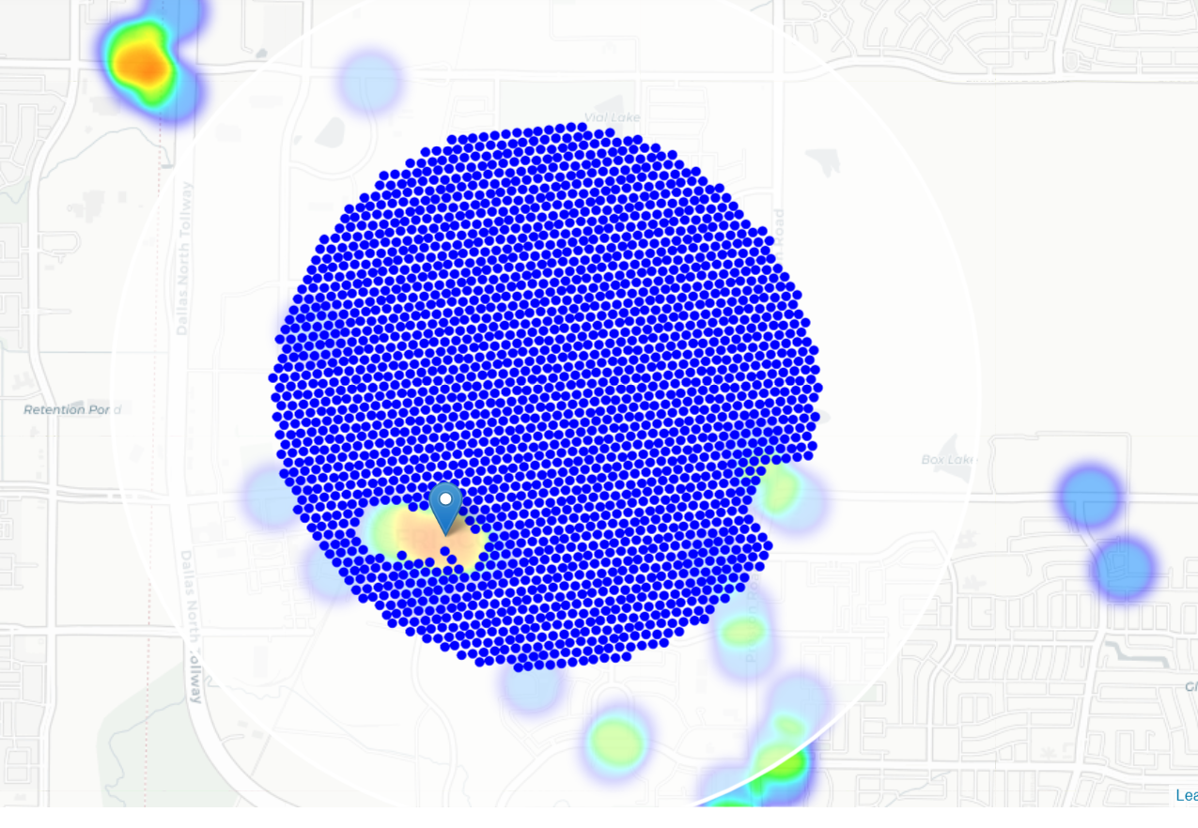
Locations with no more than two restaurants in radius of 250 meters, and no Indian restaurants in radius of 400 meters.

Slide 15
Results and Discussion
Our analysis shows that although there is a great number of restaurants in Frisco (~2000 in our initial area of interest which was 8X8 mile around Frisco), there are pockets of low restaurant density fairly close to city center. Highest concentration of restaurants was detected south, south-east and east, from Frisco, so we focused our attention to areas north, and west, closer to Little Elm and Prosper.
Those location candidates were then clustered to create zones of interest which contain greatest number of location candidates. Addresses of centers of those zones were also generated using reverse geocoding to be used as markers/starting points for more detailed local analysis based on other factors.
Result of all this is 15 zones containing largest number of potential new restaurant locations based on number of and distance to existing venues - both restaurants in general and Indian restaurants particularly. This, of course, does not imply that those zones are actually optimal locations for a new restaurant! Purpose of this analysis was to only provide info on areas close to Frisco center but not crowded with existing restaurants (particularly Indian) - it is entirely possible that there is a very good reason for small number of restaurants in any of those areas, reasons which would make them unsuitable for a new restaurant regardless of lack of competition in the area. Recommended zones should therefore be considered only as a starting point for more detailed analysis which could eventually result in location which has not only no nearby competition but also other factors taken into account and all other relevant conditions met.

Slide 16
Conclusion
Purpose of this project was to identify Frisco areas close to center with low number of restaurants (particularly Indian restaurants) in order to aid stakeholders in narrowing down the search for optimal location for a new Indian restaurant. By calculating restaurant density distribution from Foursquare data we have first identified general areas that justify further analysis, and then generated extensive collection of locations which satisfy some basic requirements regarding existing nearby restaurants. Clustering of those locations was then performed in order to create major zones of interest (containing greatest number of potential locations) and addresses of those zone centers were created to be used as starting points for final exploration by stakeholders.
Final decision on optimal restaurant location will be made by stakeholders based on specific characteristics of neighborhoods and locations in every recommended zone, taking into consideration additional factors like attractiveness of each location (proximity to park or water), levels of noise / proximity to major roads, real estate availability, prices, social and economic dynamics of every neighborhood etc.

